Slide 1
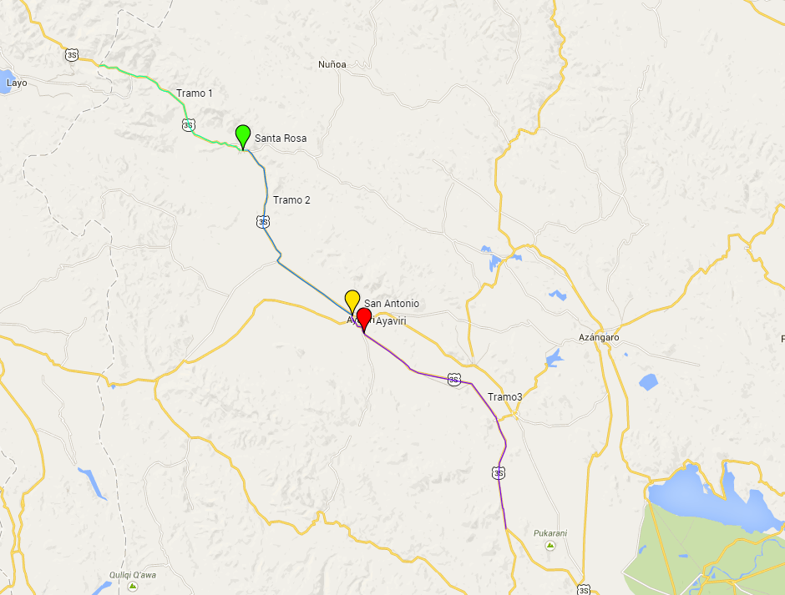
Tramo La Raya – Santa Rosa
IMD = 965 Veh./día
Tramo Ayaviri – Pucará
IMD = 1,536 Veh./día
Tramo Santa Rosa – Ayaviri
IMD = 1,595 Veh./día

Slide 2
